Slide 1


RCB-IPL Data Analysis
By :- Milin Rao Deshmukh

Slide 2
Agenda
We're on a mission to improve RCB's game. We'll use data to understand the players and their performance. and also how other factors are affecting - the toss, the venue, the key moves.
Finally, we'll put it all together and help our dream team to win.

Slide 3
Problem Statement
RCB's inconsistent performance: Analyze data to identify factors contributing to inconsistent results.
Optimizing player selection: Leverage data to inform strategic player acquisitions in the auction.
Improving match strategy: Use data to understand the impact of toss decisions, venue conditions, and playing styles.
Balancing team composition: Identify the ideal mix of batsmen, bowlers, and all-rounders for a winning team.
Data-driven recommendations: Develop actionable insights and recommendations to improve RCB's overall performance.

Slide 4
Data overview
IPL Database: We're using all the IPL data we can get our hands on to really understand what's happening with RCB.
Key Tables: We're focusing on the most important data, like how players are doing, how matches went, and the strategies teams use.
Data Sources: We're looking at the data you gave us, and maybe even some other stuff to get the full story.
Metrics: We're checking out all the important numbers: batting averages, how fast players score, how well bowlers do, and how often teams win.
Scope: We're zeroing in on RCB's past performance to see where they can improve.

Slide 5
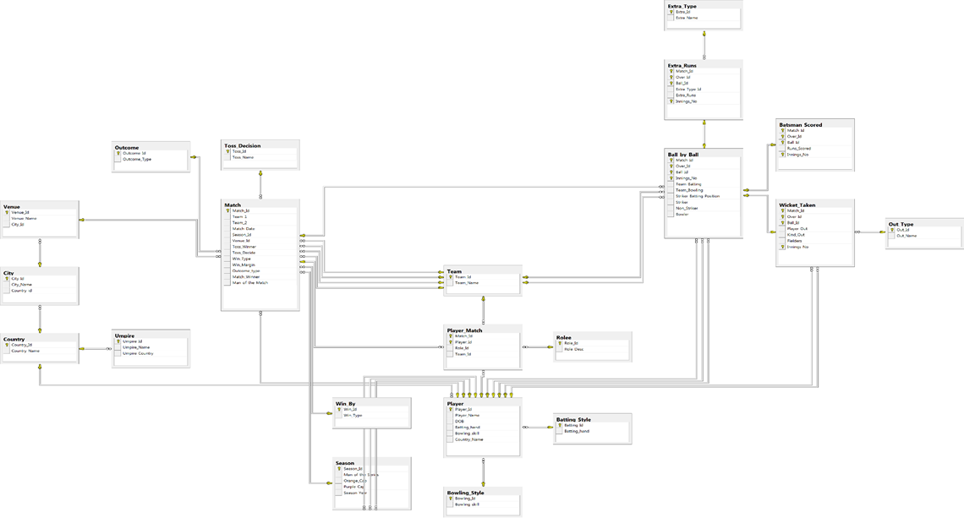
Data Schema

Slide 6
Key Data overview
IPL Database: We're using all the IPL data we can get our hands on to really understand what's happening with RCB.
Key Tables: We're focusing on the most important data, like how players are doing, how matches went, and the strategies teams use.
Data Sources: We're looking at the data you gave us, and maybe even some other stuff to get the full story.
Metrics: We're checking out all the important numbers: batting averages, how fast players score, how well bowlers do, and how often teams win.
Scope: We're zeroing in on RCB's past performance to see where they can improve.

Slide 7
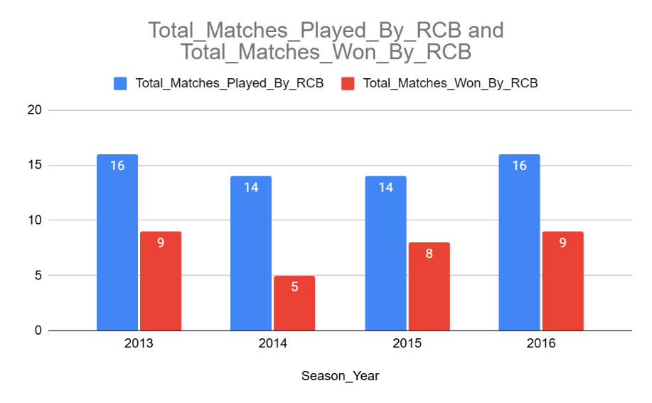
Key factors
RCB Wins vs. Matches Played
Approach:
We looked at how many matches RCB played and won each year to see how consistent their wins were.
Insights:
RCB played about the same number of matches each year (14-16). But their wins jumped around a lot!
They won the most in 2013 and 2016 (9 wins each), but way less in 2014 and 2015. More games doesn't mean more wins.
Recommendations:
Wins: They need to win more consistently. More wins each year, no big jumps or drops.
Why they win: What made 2013 and 2016 so good? Do that again and Figure out what works.

Slide 8
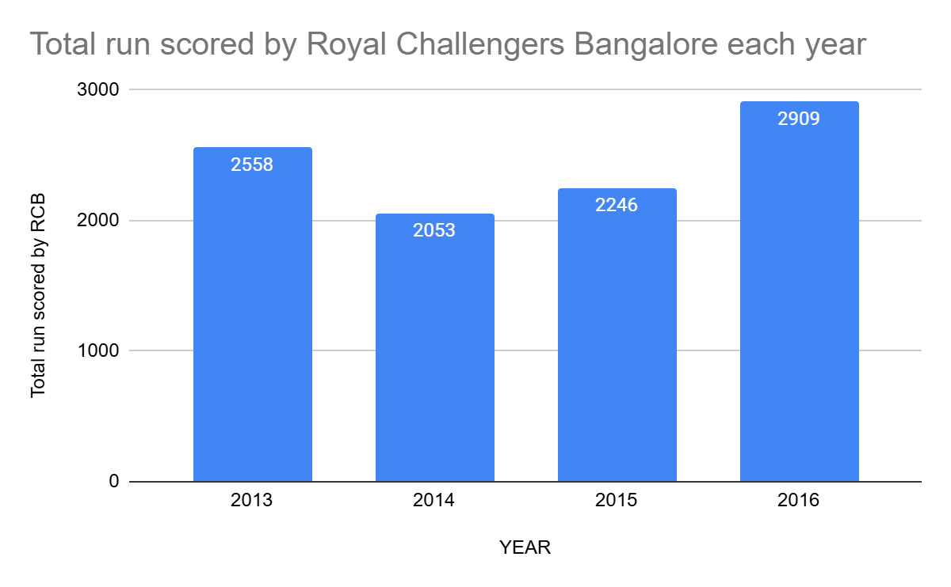
Key factors
RCB Performance (Runs Score)
Approach:
We will look at how many runs RCB scored each year to see if there's a pattern and where they can improve.
Insights:
RCB's runs are all over the place! 2016 was amazing (2909 runs), but 2014 was rough (2053 runs). They need to find a way to be good every year.
Recommendations:
Batting: Figure out what clicked in 2016 and do that all the time.
Strategy: They struggle at the start of the season. But If they improve that same way, they'll be much stronger.

Slide 9
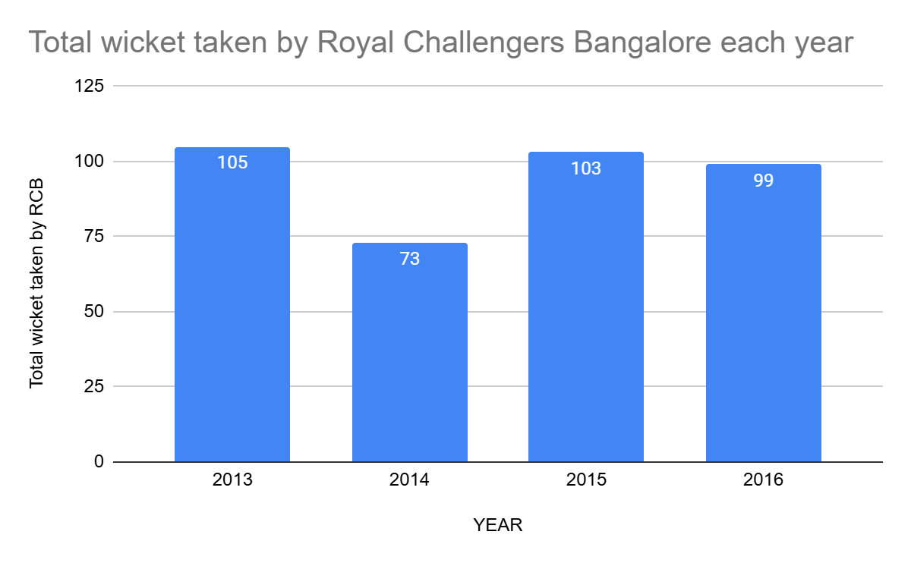
Key factors
RCB performance Wickets Taken Over Time
Approach:
We checked RCB's wickets each year to see how their bowling performed.
Insights:
RCB's wickets are inconsistent. Good years (2013, 2015, 2016) and bad years (2014). Their bowling isn't reliable.
Recommendations:
Consistent Wickets: Find a bowling plan that works every year.
Learn From the Best: What made some years better? Do that again! Avoid the bad years.

Slide 10
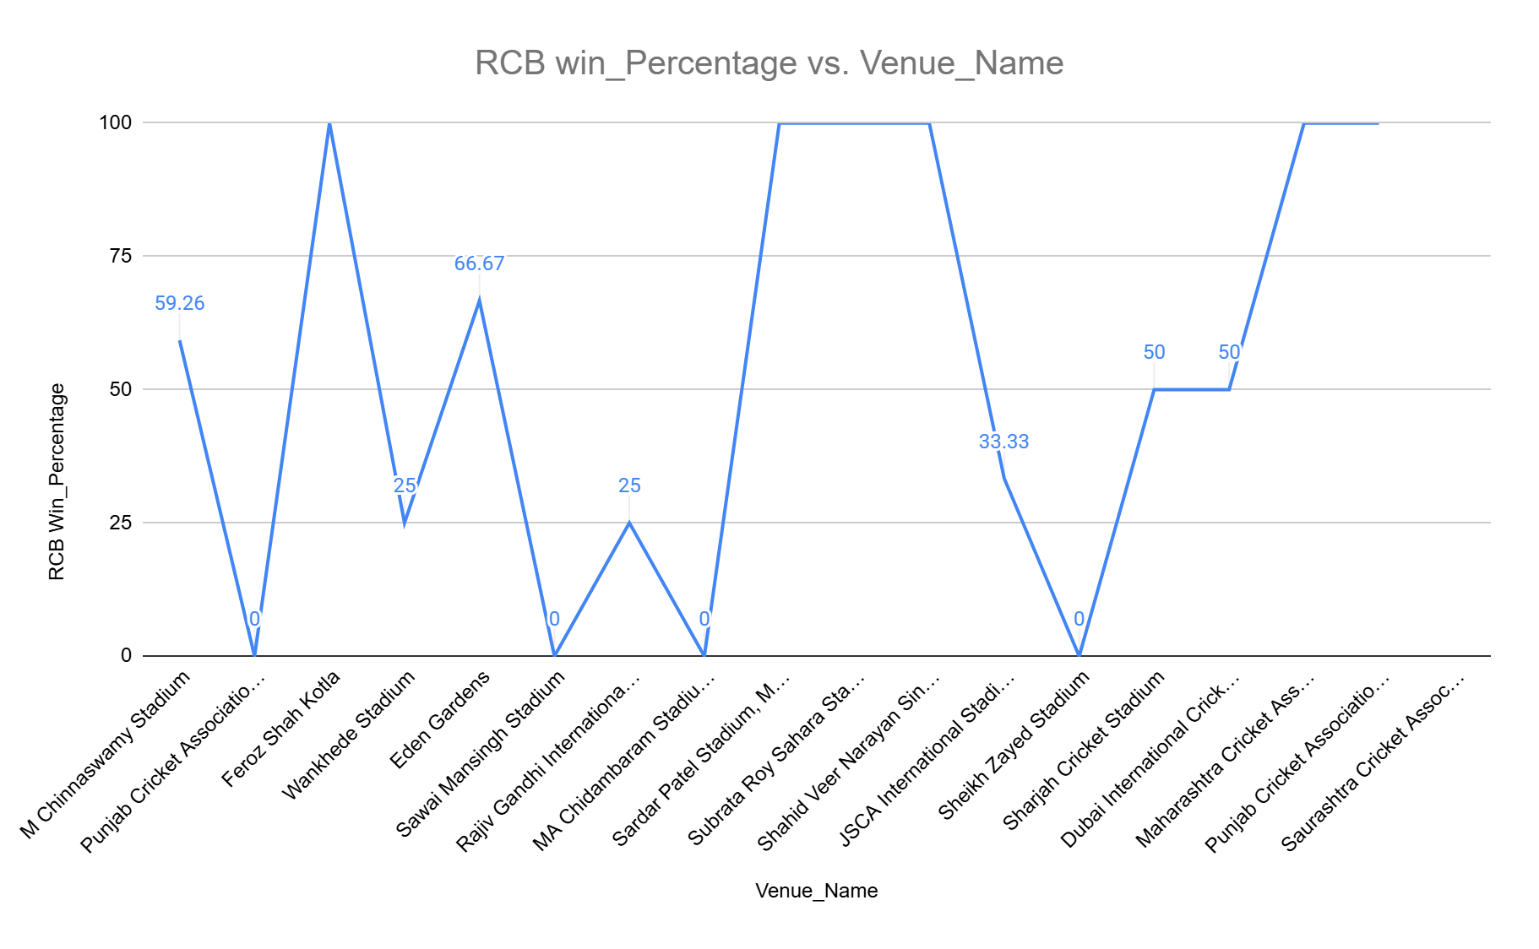
Key factors
RCB performance Wickets Taken Over Time
Approach:
We checked RCB's wins at each place they played.
Insights:
Home best: Chinnaswamy wins! (59%).
Uneven wins: Some places great (100%), some terrible (0%). Venue matters.
Few games: Some 100% wins might be lucky.
Recommendations:
Home Wins: Keep winning at home! Learn why.
Road Tactics: Need plans for each place. Fix the bad ones. Play more to learn.

Slide 11
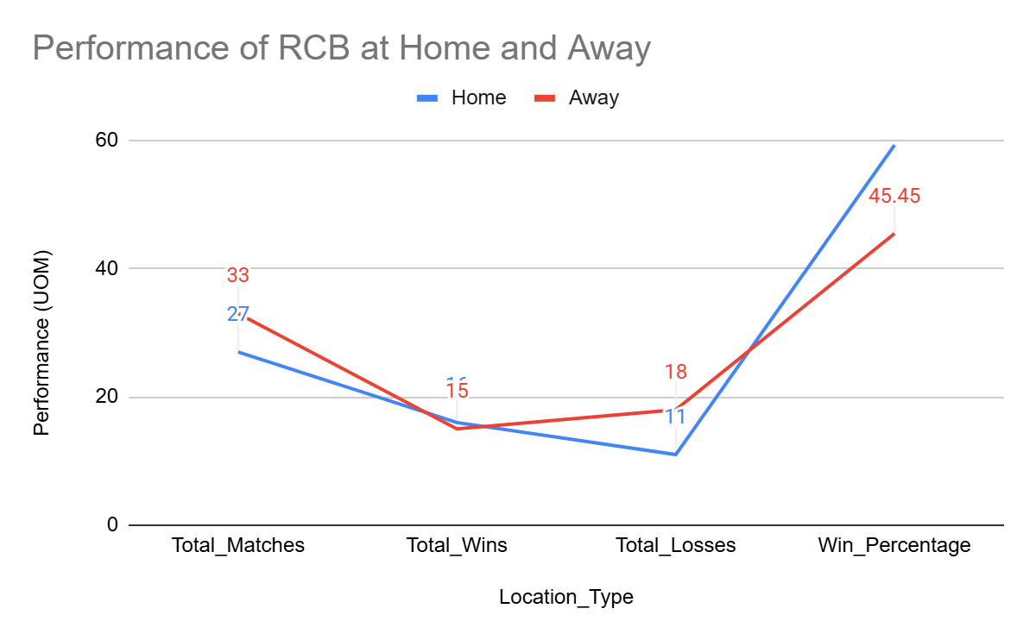
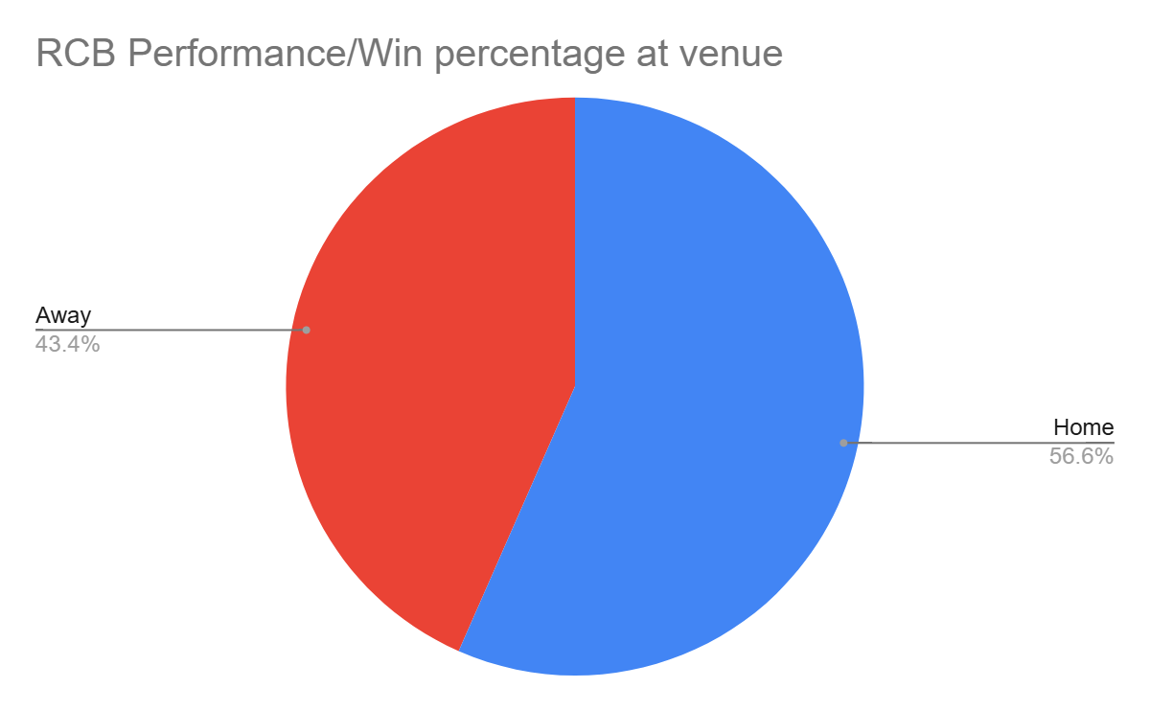
Key factors
RCB performance Wickets Taken Over Time
Approach: We compared RCB's home and away wins to see where they perform best.
Insights:
Home Dominance: RCB wins significantly more at home (56.6%) than away (43.4%). The pie chart highlights this clear difference.
Win Disparity: They're much stronger at home.
Recommendations:
Home Power: Keep winning at home! Figure out what makes home so successful and replicate it.
Away Fix: Improve away performance. Investigate and address the reasons for lower away win rates. Develop specific away-game strategies.

Slide 12
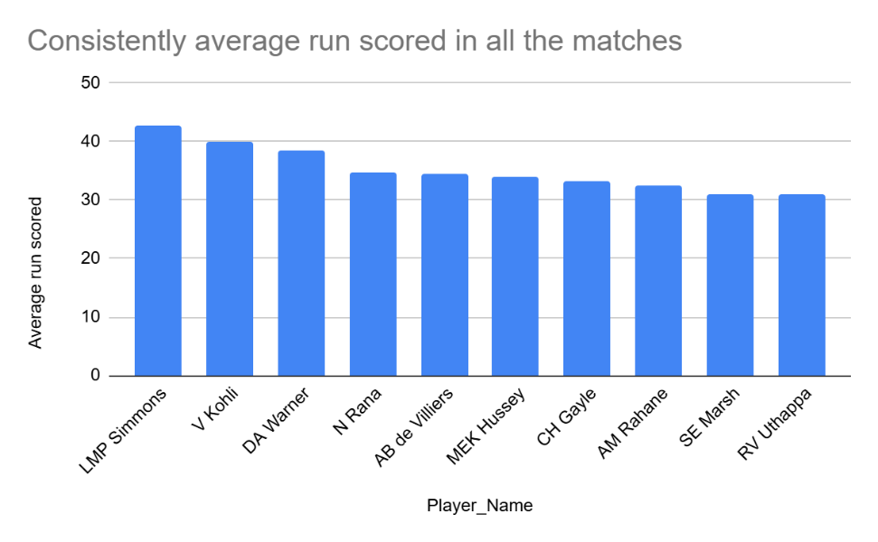
Key factors
RCB Top 10 Batsmen Performance
Approach: We analysed average runs scored by batsmen to identify consistent performers.
Insights:
Top Performers: LMP Simmons leads with the highest average runs.
Consistent Scoring: Top batsmen show relatively close average scores.
High Average: The top 10 batsmen maintain a high average, indicating consistency.
Recommendations:
Consistent Players: Focus on recruiting batsmen with high average scores.
Analyse Top Performers: Study the playing style of top performers like Simmons to understand their consistency.

Slide 13
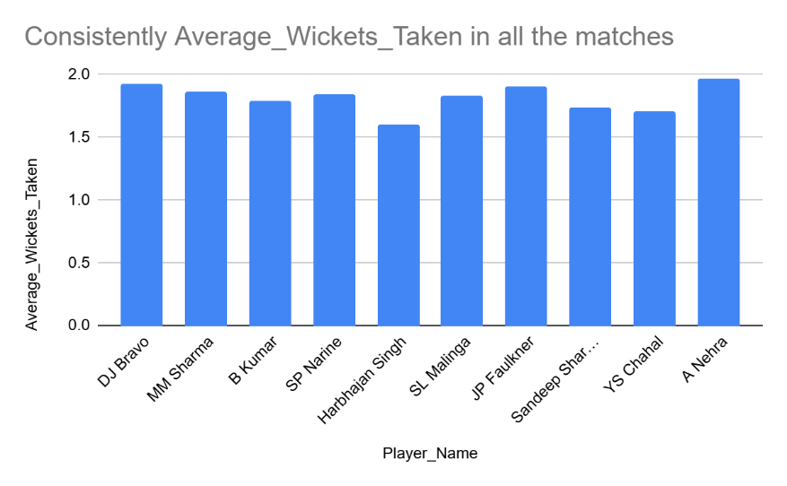
Key factors
RCB Top 10 Bowlers Performance
Approach: Analysed average wickets taken by bowlers.
Insights:
Top Wicket-Takers: A Nehra and DJ Bravo lead in average wickets.
Close Competition: Top bowlers have similar high averages
Recommendations:
Consistent Bowlers: Recruit high-average wicket-takers.
Analyse Top Bowlers: Study top bowlers' techniques.

Slide 14
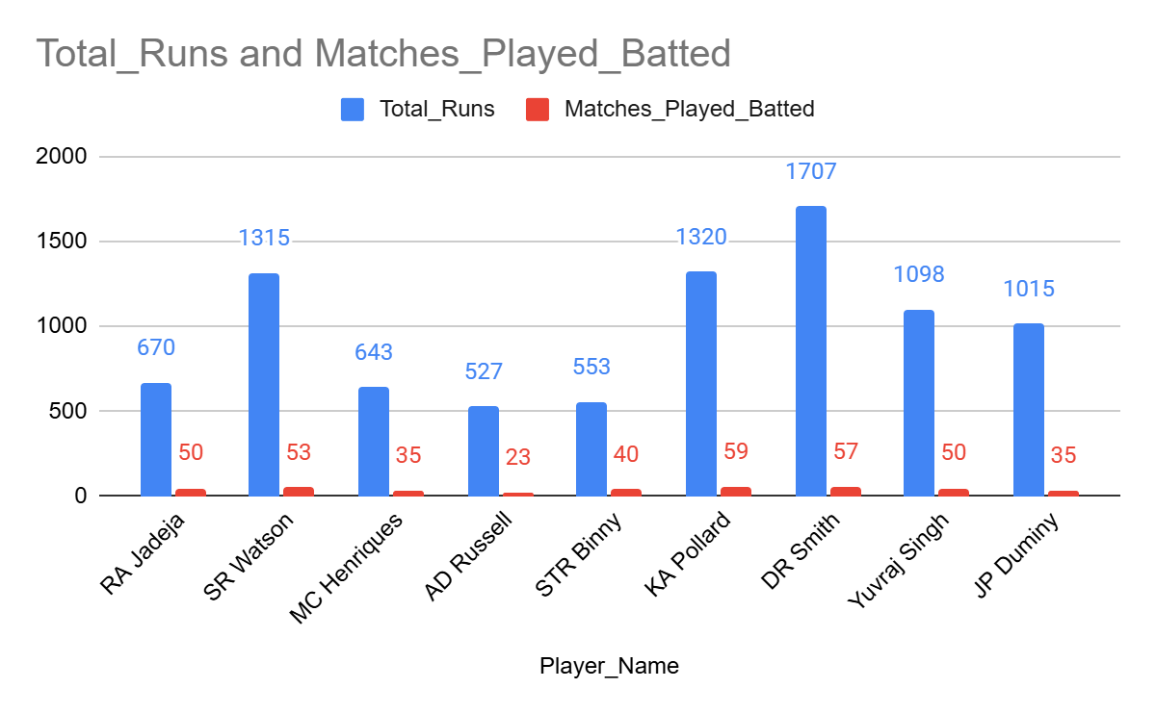
Key factors
RCB Top 10 All Rounder Performance
Approach: Analysed all-rounders' wickets, runs, and matches.
Insights:
Top All-Rounders: Jadeja and Watson lead in wickets.
Impactful Players: Russell and Henriques show strong all-around value.
Variable Performance: Performance varies across different all-rounders.
Recommendations:
Key All-Rounders: Retain impactful all-rounders.
Balance: Maintain a balance of bowling and batting all-rounders.

Slide 15
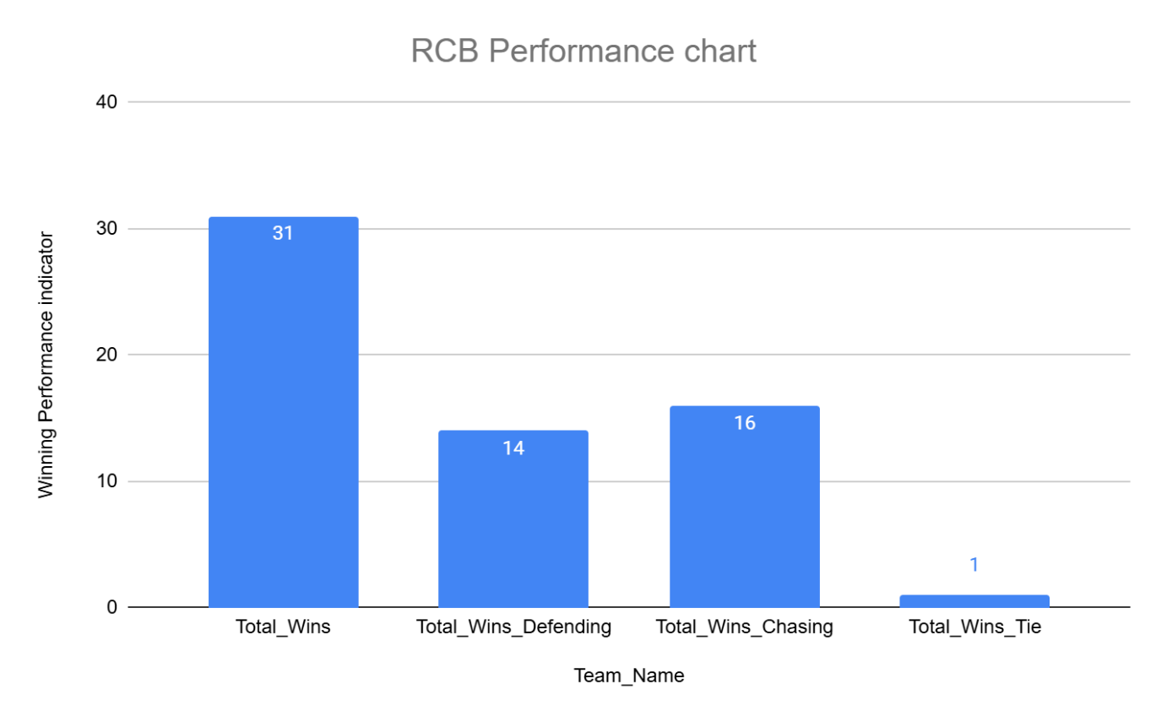
Key factors
RCB Winning Performance: Chasing vs. Defending
Approach: We analysed RCB's wins based on chasing or defending to understand their strengths.
Insights:
Chasing Advantage: RCB wins more when chasing (16) than defending (14).
Total Wins: 31, including one tie-break win.
Recommendations:
Chase Strategy: Identify key factors for success and refine chasing tactics.
Defending Boost: Improve bowling and fielding strategies to strengthen defence.

Slide 16
Recommendations:
Consistency: RCB needs to address inconsistency in batting, bowling, and overall performance.
Home Advantage: Leverage the home advantage by understanding contributing factors and replicating them in away games.
Strategic Improvement: Develop specific strategies for chasing and defending, and for different venues.
Player Roles: Define clear roles for all-rounders and other players based on their strengths.
Data-Driven Decisions: Use data analysis to inform player recruitment, strategic decisions, and performance monitoring.

Slide 17
Conclusion
Data Insights: Data analysis reveals key areas for improvement in RCB's performance, including inconsistency, home vs. away disparity, and strategic weaknesses.
Actionable Recommendations: Implementing the recommendations, focusing on data-driven decision-making, and addressing early-season struggles can lead to increased consistency and better results.
Continuous Improvement: Continuous monitoring and data-driven adjustments are crucial for sustained success. Regularly review performance data and adapt strategies as needed to stay ahead of the competition.

Slide 18
Thank you

